Slide 1
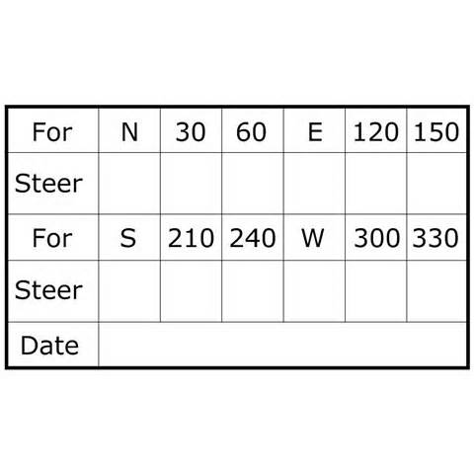
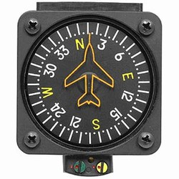
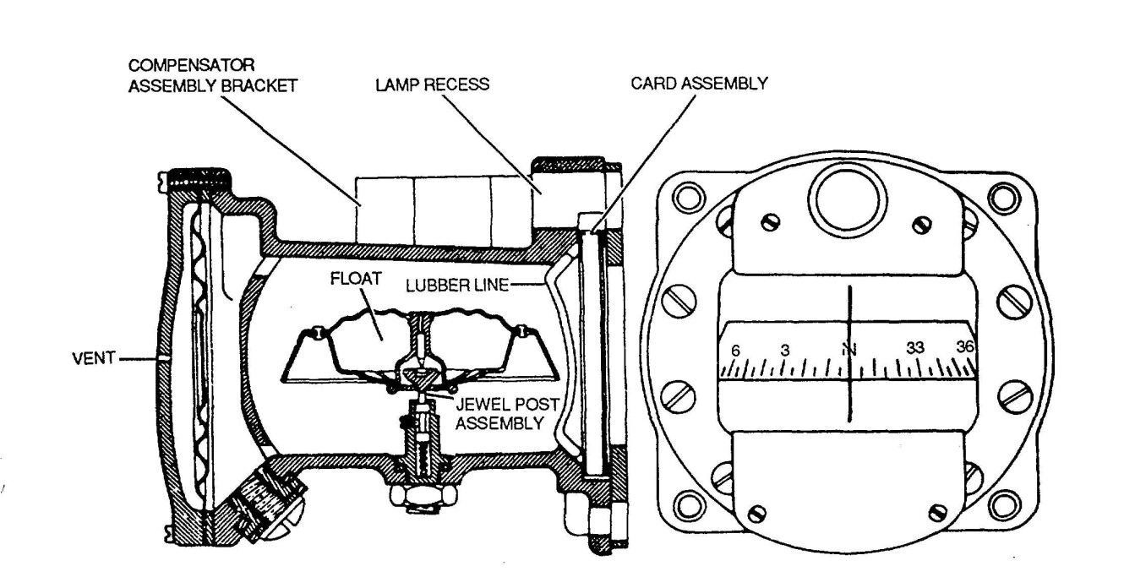
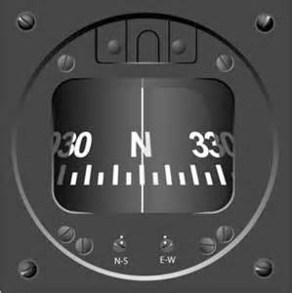
COMPASS TURNS

Slide 2
Why Use A Compass Turn
Compass turns are used in aircraft using only a magnetic compass for guidance
Generally used when the directional gyro ceases to function properly
Compass will operate despite failures in the electrical, vacuum or pitot static systems
The compass can be used to verify that the aircraft is on the correct heading at the conclusion of a turn
However, the construction of the compass and the alignment of the magnetic poles of the earth can cause the magnetic compass to exhibit several significant limitations when used for navigation.
However, if the pilot is aware of the limitations, a compass can be used effectively for navigation

Slide 3
Compass Construction
As the aircraft (and thus the compass housing) turns, the compass card portion of the compass card remains generally stationary with respect to its orientation to the earth due to magnetic attraction. In essence, the aircraft turns around the compass’ floating card
Compass Construction
The compass consists of a compass card with a magnetized bar attached
The compass card is balanced on a low friction pin (jewel post)
The compass card is balanced with a small dip-compensating weight, so it stays relatively level when operating in the middle latitudes of the northern hemisphere
The compass card floats in a case filled with kerosene
The magnetized bar tends to orient the assembly with the magnetic field of the earth
The earth is a huge magnet, with lines of force oriented approximately north and south. Because the aircraft compass card is suspended to swing freely, it generally aligns with the earth's magnetic lines of force. However, the magnetic north pole is located 1300 miles from the geographic north pole
The bar turns the compass card, which changes the visible portion of the compass card shown in the window. The outside surface of the compass card is etched with the markings that indicate magnetic directions

Slide 4
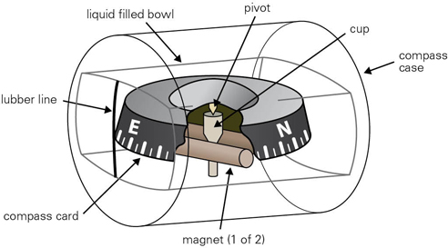
Compass Construction

Slide 5
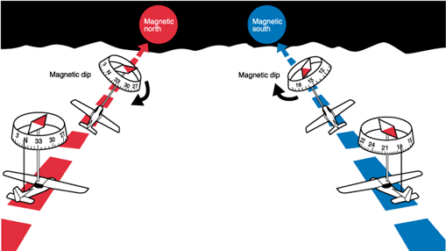
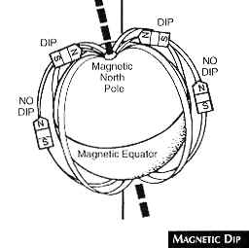
Compass Errors – Dip Error
The compass card tends to align itself with the earth's magnetic field. At or near the Equator this causes little or no problem, but as the aircraft nears either of the magnetic poles, the dip error becomes significant as the earth’s magnetic field dips into the earth

Slide 6
Compass Errors – Dip Error
The compass card’s center of gravity is well below the pivot point on the pin or post. When the aircraft is in a banked turn, the compass card also banks because of centrifugal force. While the compass card is in the banked attitude, the vertical component of the earth's magnetic field causes the compass to dip to the low side of the turn
Dip error is most apparent when turning through headings close to north and south
When turning from north, the compass lags or briefly indicates a turn in the opposite direction
When turning from south, the compass indicates a turn in the correct direction bur at a considerably faster rate than is actually occurring
The amount of lag decreases as the turn continues, then disappears as the airplane reaches a heading of east or west
Reversed in the Southern hemisphere
Northerly turning error occurs only while the aircraft is turning
Mnemonic - UNOS (Undershoot North, Overshoot South)

Slide 7
Compass Errors – Dip Error
Turn Process in the Northern Hemisphere
Turning from a northerly heading
The compass gives an initial indication of a turn in the opposite direction or lags
It then begins to show the turn in the proper direction, but lags behind the actual heading
The amount of lag decreases as the turn continues, then disappears as the airplane reaches a heading of east or west
Turning from a southerly heading
Compass gives an indication of a turn in the correct direction, but leads the actual heading
Error disappears as the airplane approaches an easterly or westerly heading
Turning from an easterly or westerly heading towards the north
There is no error as the turn begins
Then as the heading approaches north, the compass increasingly lags behind the airplane's actual heading

Slide 8
Compass Errors – Dip Error
Turn Process in the Northern Hemisphere
When turning from an easterly or westerly heading towards the south
There is no error as the turn begins
Then as the heading approaches the south, the compass increasingly leads the actual heading
The amount of lead or lag is approximately equal to the latitude of the airplane +/- the normal roll-out lead
When turning to the north add the lead normally used for roll-out to the undershoot amount
When turning to the south subtract the lead normally used for roll-out from the over-shoot amount
For example, if turning from a southerly heading to a westerly heading while at 40° north latitude, the compass will rapidly turn to a heading of 220° (180° + 40°). At the midpoint of the turn, the lead decreases to approximately half (20°), and upon reaching a heading of west, the lead is zero

Slide 9
Compass Turn Technique
When turning towards the north, lead the heading by an amount equal to (i) the latitude plus (ii) half the angle of bank
When turning to a heading of south over-shoot the heading by an amount equal to (i) the latitude minus (ii) half the angle of bank
The lead or lag, as applicable, must be interpolated when turning to intermediate headings

Slide 10
Compass Errors – Acceleration Error
When an aircraft accelerates compass errors occur and are most apparent on headings of east and west
The errors are caused by a combination of inertia and magnetic dip
The dip-correction weight causes the end of the compass card (the south-seeking end) to be heavier than the opposite end. At constant speeds on a heading of east or west, the compass card is level as the effects of magnetic dip and the weight are approximately equal. When the aircraft accelerates, the inertia of the weight holds its end of the compass card back and the card rotates toward north
As the aircraft accelerates, the compass card, acting like a pendulum, tilts slightly on the pin during the acceleration

Slide 11
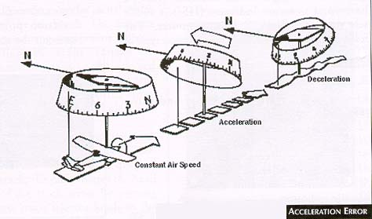
Compass Errors – Acceleration Error
The momentary tilting of the compass card displaces the compass card from its normal alignment with magnetic north
When the aircraft accelerates in either an easterly or westerly direction, the compass card will momentarily indicate a turn toward the north
When the aircraft decelerates in either an easterly or westerly direction, the compass card will momentarily indicate a turn toward the south
Mnemonic – ANDS (accelerate north, decelerate south) - SAND in the southern hemisphere

Slide 12
Compass Errors – Movement Errors
Abrupt changes in attitude or airspeed and the resulting erratic movements of the compass card make accurate interpretations of the instrument very difficult
Turbulence can also cause the compass to bounce or move on its pivot point
The jewel-and-pivot mounting of the compass card allows the compass card freedom to rotate and tilt up to approximately 18° angle of bank and pitch
At steeper bank and pitch angles, the compass indications are erratic and unpredictable

Slide 13
Compass Pilot Induced Error
It can be easy to begin a turn in the wrong direction because the compass card appears backward
For example, East is on what the pilot would expect to be the west side
The vertical card magnetic compass can eliminate some of the errors and confusion
Right side versus left side indication

Slide 14
Deviation
Local magnetic fields in an aircraft caused by electrical current flowing in the structure, in nearby wiring or any magnetized part of the structure, cause a compass error called deviation
Deviation can be different on different headings, but it is not affected by the geographic location
Any error that cannot be removed by properly aligning the compass is recorded on a compass correction card and placed in a card-holder near the compass
Corrections for variation and deviation must be applied in the correct sequence and is shown below starting from the true course desired
Correction card

Slide 15
Variation
Maps and charts are drawn using meridians of longitude that pass through the geographic north and south poles
Directions measured from the geographic poles are called true directions
The north magnetic pole, to which the magnetic compass points, is located approximately 1300 miles from the geographic north pole
Directions measured from the magnetic poles are called magnetic directions
In aerial navigation, the difference between true and magnetic directions is called variation
The degree of variation depends on the aircraft’s location in relation to the poles
Variation error does not change with the heading of the aircraft

Slide 16
Variation
Points of equal variation are connected by an isogonic magenta dashed line on charts
The line with zero variation is called the agonic line – Generally runs from New Orleans, LA. through a point east of International Falls, MN. in 2013
East of the Agonic line, the magnetic pole is to the west of the geographic pole – Westerly variation
West of this line, the magnetic pole is to the east of the geographic pole – Easterly variation
Variation changes over time and thus the agonic line will change locations
To fly a true course, the variation must be corrected
For westerly variation add the variation to the true course to find the magnetic course
For easterly deviation subtract the variation from the true course to find the magnetic course
Pneumonic - West is best (+), East is least (-)

Slide 17
Correct Course / Heading
A. Determine the Magnetic Course:
1. Find True Course (180°)
2. Add or subtract the variation for the area from the chart (+10°)
Equals the Magnetic Course (190°)
B. Wind Correction – Magnetic Heading
Magnetic Course (-L)(+R)Wind correction angle = Magnetic Heading
C. Determine the Compass Heading:
1. Find the magnetic heading (190°, from above with calm winds)
2. Add or subtract the deviation, as applicable, for the magnetic heading from the compass correction card (-2°, from correction card)
If the magnetic course is not listed on the correction card, you will need to interpolate
Equals the Compass heading (188°)

Slide 18

Questions

Slide 19
Disclaimer
Instrument flight can be dangerous. Do not rely solely on this presentation – PROFESSIONAL INSTRUCTION IS REQUIRED
The foregoing material should not be relied upon for flight.
ALTHOUGH THE ABOVE INFORMATION IS FROM SOURCES BELIEVED TO BE RELIABLE SUCH INFORMATION HAS NOT BEEN VERIFIED, AND NO EXPRESS REPRESENTATION IS MADE NOR IS ANY TO BE IMPLIED AS TO THE ACCURACY THEREOF, AND IT IS SUBMITTED SUBJECT TO ERRORS, OMISSIONS, CHANGE.

